Slide 1

CSE 591 Multivariate Data Visualization
Ross Maciejewski
rmacieje@asu.edu

Slide 2
Univariate Data Visualization
Last Lecture
Histograms
Box and Whisker Plots
Line Graphs
What if we have multivariate data?
Today we want to discuss techniques for

Slide 3
Representation
What are the two main ways of presenting multivariate data sets?
Directly (textually) – Tables
Symbolically (pictures) – Graphs
How do we decide which to use, and when?
1 – Descriptions on this slide are borrowed from John Stasko’s “Multivariate Data & Tables and Graphs” lecture: http://www.cc.gatech.edu/~stasko/7450/Notes/data.pdf

Slide 4
Tables?
Use tables when
The document will be used to look individual value
The document will be used to compare individual values
Precise values are required
The quantitative info to be communicated involves more than one unit of measure
Use graphs when
The message is contained in the shape of the values
The document will be used to reveal relationships among values
1 – Descriptions on this slide are borrowed from John Stasko’s “Multivariate Data & Tables and Graphs” lecture: http://www.cc.gatech.edu/~stasko/7450/Notes/data.pdf
2 - S. Few, Show Me the Numbers: Designing Tables and Graphs to Enlighten,

Slide 5
Graphs?
Graph
Visual display that illustrates one or more relationships among entities
Shorthand way to present information
Allows a trend, pattern or comparison to be easily comprehended
Critical to remain task-centric
Why do you need a graph?
What questions are being answered?
What data is needed to answer those questions?
Who is the audience?
1 – Descriptions on this slide are borrowed from John Stasko’s “Multivariate Data & Tables and Graphs” lecture: http://www.cc.gatech.edu/~stasko/7450/Notes/data.pdf

Slide 6
Name | Team | At Bats | Runs | RBI | Batting Ave
C. Gonzalez | COL | 587 | 111 | 117 | 0.336
J. Votto | CIN | 547 | 106 | 113 | 0.324
O. Infante | ATL | 471 | 65 | 47 | 0.321
T. Tulowitzki | COL | 470 | 89 | 95 | 0.315
M. Holiday | STl | 596 | 95 | 103 | 0.312
A. Pujols | STL | 587 | 115 | 118 | 0.312
M. Prado | ATL | 599 | 100 | 66 | 0.307
R. Zimmerman | WSH | 525 | 85 | 85 | 0.307
R. Braun | MIL | 619 | 101 | 103 | 0.304
S. Castro | CHC | 463 | 53 | 41 | 0.3
H. Ramirez | FLA | 543 | 92 | 76 | 0.3
P. Polanco | PHI | 554 | 76 | 52 | 0.298
A. Gonzalez | SD | 591 | 87 | 101 | 0.298
J. Werth | PHI | 554 | 106 | 85 | 0.296
M. Byrd | CHC | 580 | 84 | 66 | 0.293
A. Ethier | LAD | 517 | 71 | 82 | 0.292
A. Pagan | NYM | 579 | 80 | 69 | 0.29
A. Huff | SF | 569 | 100 | 86 | 0.29
J. Keppinger | HOU | 514 | 62 | 59 | 0.288
D. Uggla | FLA | 589 | 100 | 105 | 0.287
National League Batting Average Leaders 2010

Slide 7
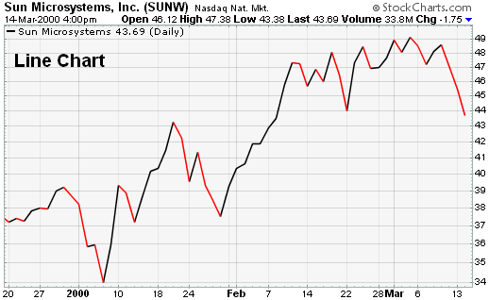
Univariate Case
In univariate representations, we think of data case as being shown along one dimension and value in another
4
3
Frequency count of batting average
2
1
.287
.292
.297
.302
.307
.312
.316
.321
.326
.331
.336
Batting average

Slide 8
Bivariate Case – Stacked Bar Graph
4
A. Ethier
A. Gonzalez
3
M. Byrd
J. Werth
R. Braun
A. Pujols
2
S. Castro
P. Polanco
M. Prado
R. Zimmerman
M. Holiday
J. Votto
1
O. Infante
J. Keppinger
A. Pagan
H. Ramirez
A. Huff
T. Tulowitzki
D. Uggla
C. Gonzalez
0
40
50
60
70
80
90
100
110
120
Runs Batted In
T. N. Dang, L. Wilkinson and A. Anand, “Stacking Graphic Elements to Avoid Over-Plotting," IEEE Transactions on Visualization and Computer Graphics, vol. 14, no. 6, pp. 1044-1052, 2010.

Slide 9
Bivariate Case - Scatterplot
Visualizes discrete data values along two axes
Used as a means of analyzing bivariate relationships
Quick means of assessing outliers, clusters and distributions
Putting a line through the data can help assess trends, but can also mislead viewer
Batting Average
Number of Runs

Slide 10
Scagnostics
Scatterplot diagnostics
Graph-theoretic measures for detecting a variety of structural anomalies in a geometric graph representation of scatterplot data
Ratings can be used to pick views that show particular structures that are of interest to the user
Coined by Tukey, but never published, it is an exploratory graphical technique to help determine notable relationships between two variables
1 - J. Tukey and P. Tukey. Computing graphics and exploratory data analysis: An introduction. In Proceedings of the Sixth Annual Conference and Exposition: Computer Graphics 85. In Proceedings of the Sixth Annual Conference and Exposition: Computer Graphics, pages 773–785, 1985.
2 - L. Wilkinson, A. Anand, and R. Grossman. Graph-theoretic scagnostics.In Proceedings Information Visualization, pages 157–164. IEEE CS
Press, 2005.

Slide 11
Scagnostics
Wilkinson et al. propose nine scagnostic measures to characterize the scatterplots
Measures have proven statistical properties that are computable for modern datasets (available as a free downloadable package in R)
Outlying
Sparse
Striated
Skinny
Monotonic
Skewed
Clumpy
Convex
Stringy
1 - J. Tukey and P. Tukey. Computing graphics and exploratory data analysis: An introduction. In Proceedings of the Sixth Annual Conference and Exposition: Computer Graphics 85. In Proceedings of the Sixth Annual Conference and Exposition: Computer Graphics, pages 773–785, 1985.
2 - L. Wilkinson, A. Anand, and R. Grossman. Graph-theoretic scagnostics.In Proceedings Information Visualization, pages 157–164. IEEE CS
Press, 2005.

Slide 12
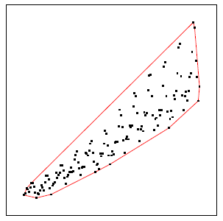
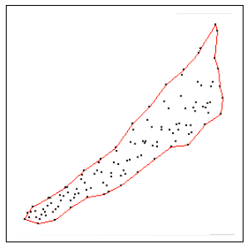
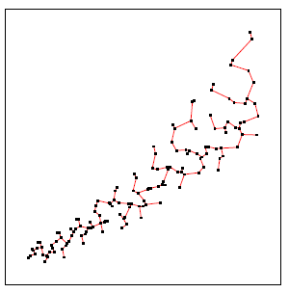
Scagnostics - Methods
Graph Theoretic Scagnostics are based on Geometric Graphs
Convex Hull (the outer edges of a Delaunay triangulation)
Alpha Hull (a generalization of the convex hull and a subgraph of the Delaunay triangulation)
Minimum Spanning Tree
Convex Hull Alpha Hull Minimum Spanning Tree
1 - L. Wilkinson, A. Anand, and R. Grossman. Graph-theoretic scagnostics.In Proceedings Information Visualization, pages 157–164. IEEE CS
Press, 2005.

Slide 13
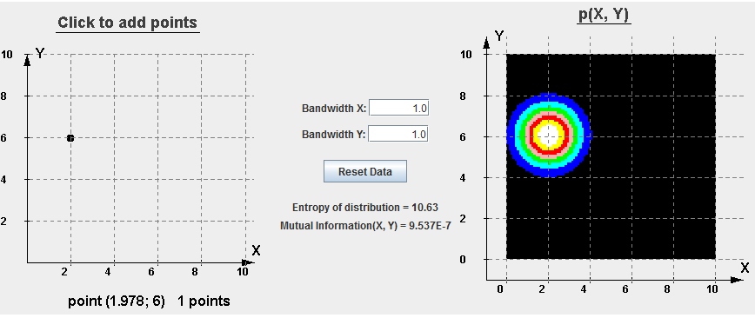
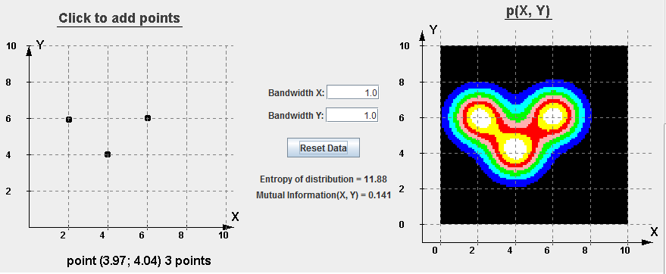
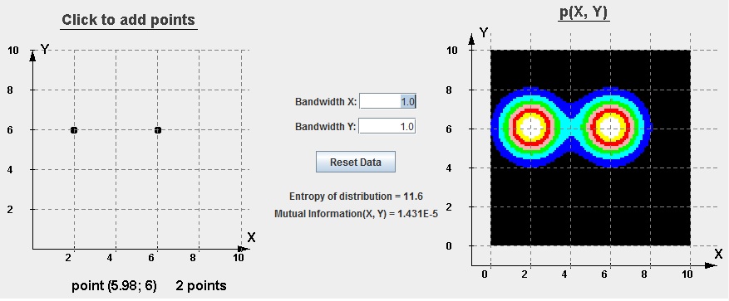
Multivariate Density Estimation
Kernel Density Estimation
Continuous Scatterplots
1 – B. W. Silverman. Density Estimation for Statistics and Data Analysis. Chapman & Hall/CRC, 1986.
- http://parallel.vub.ac.be/research/causalModels/tutorial/kde.html
2 - S. Bachthaler and D. Weiskopf, “Continuous Scatterplots," IEEE Transactions on Visualization and Computer Graphics, vol. 14, no. 6, pp. 1428-1435, 2008.

Slide 14
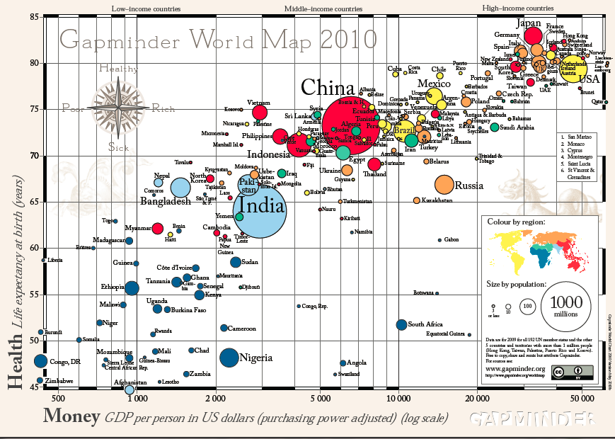
Multivariate Case
http://www.gapminder.org/GapminderMedia/wp-uploads/pdf_charts/GWM2010.pdf

Slide 15
Multivariate Case - Mosaic Plot
Graphical display that allows you to examine the relationship among two or more categorical variables
Start as a square with length one
Divide first into horizontal bars whose widths are proportional to the probabilities associated with the first categorical variable
Next each bar is split vertically by the conditional probability of the second categorical variable

Slide 16
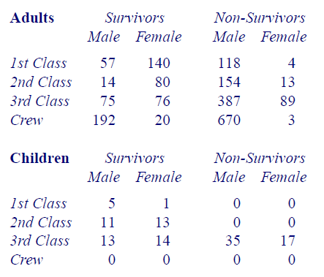
The Titanic Example

Slide 17
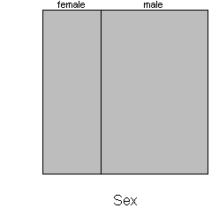
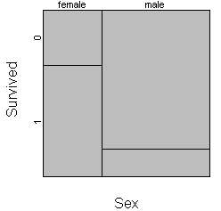
The Titanic Example
Mortality rates between men and women on the Titanic
http://www.childrensmercy.org/stats/definitions/mosaic.htm.

Slide 18
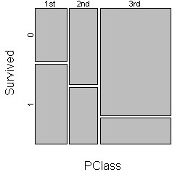
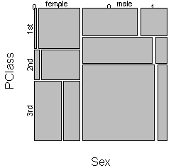
The Titanic Example

Slide 19
Perceptual Basis for Mosaic Plot
It is tempting to dismiss mosaic plots because they represent counts as rectangular areas and so provide a distorted perceptual encoding
In fact, the important encoding is the length
At each stage, the comparison of interest is of the length of the sides

Slide 20
Small Multiples
Give each variable its own display (sometimes called Trellis Chart, Grid Chart)
Use the same graphic to display different slices of a dataset
We want to ask questions about our data, how does X compare to Y?
Placement of the small multiples should reflect some logical order in order to guide user
Should share the same measures, scales, size and shape
Simplicity is key as users need to ingest large number of charts at once
Tufte, Edward (1983). Visual Display of Quantitative Information.

Slide 21
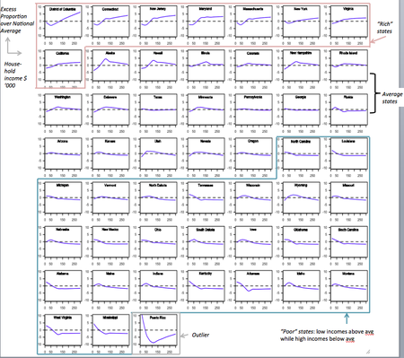
http://junkcharts.typepad.com/junk_charts/small_multiples/

Slide 22
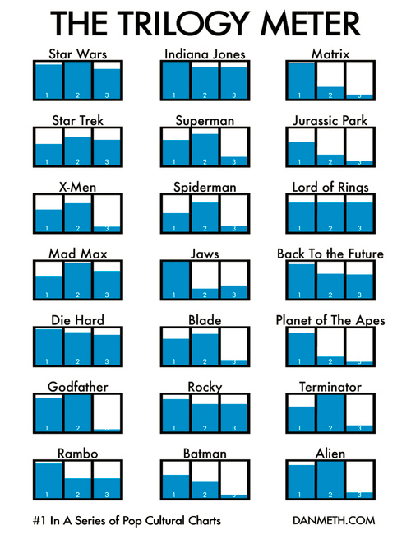
http://www.juiceanalytics.com/writing/better-know-visualization-small-multiples/

Slide 23
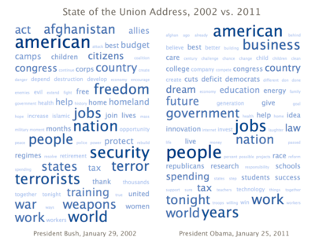
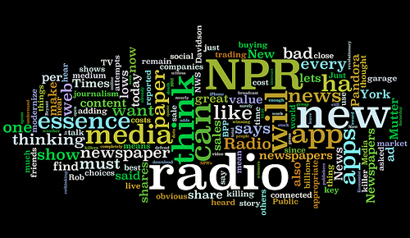
Tag Clouds and Wordles
Visual representation for text data where words are placed and scaled based on some statistical measures
Font size is typically determined by the number of instances a word is used
Text cloud comparing 2002 State of the Union Address by U.S. President Bush and 2011 State of the Union Address by President Obama. Created at TagCrowd.
Viegas, FB, Wattenberg, M, Feinberg, J, “Participatory Visualization with Wordle, IEEE Transactions on Visualization and Computer Graphics 15(6)1137-1144

Slide 24
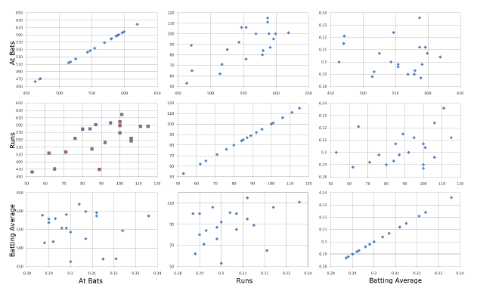
Multivariate Case - Scatterplot Matrix

Slide 25
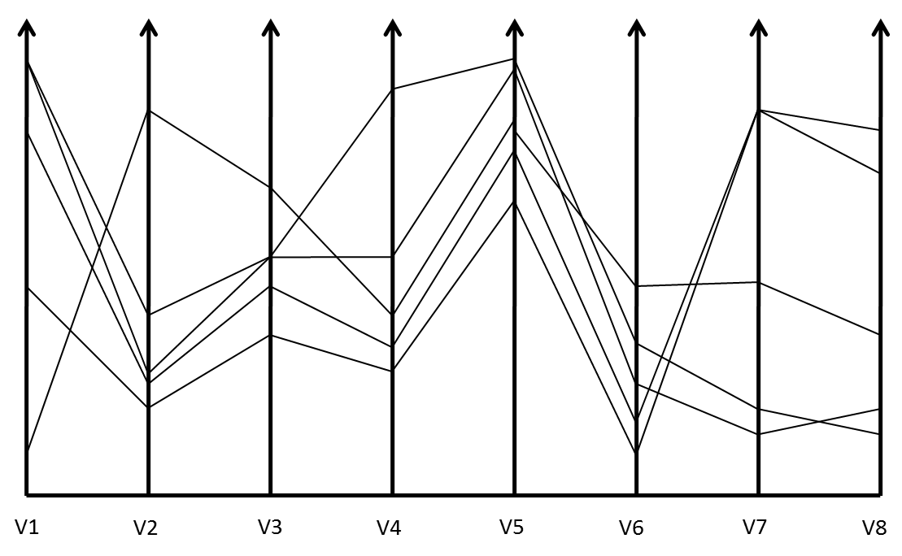
Parallel Coordinate Plots
1 - Inselberg A (1985) The Plane with Parallel Coordinates. The Visual Computer1(4):69-91
2 - Ankerst M, Berchtold B, Keim DA (1998) Similarity clustering of dimensions for an enhanced visualization of multidimensional data. IEEE Symposium on Information Visualization pp 52-62

Slide 26
Issues With Parallel Coordinate Plots
Different variables can take different values with very different ranges
Need to normalize data ranges (maybe do a power transformation and then a normalization?)
Order of the parallel coordinate plots has a major impact on the resultant visualization
The more variables we plot, the more lines we get and the more clutter that we get
1 -Yang, J., Peng, W., Ward, M.O., Rundensteiner, E.A., Interactive hierarchical dimension ordering, spacing and filtering for exploration of high dimensional datasets. In Proc. of IEEE Symposium on Information Visualization (2003), pp. 105–112.
2 – Zhou, H., Yuan, X., Qu, Huamin, Cui, W., Chen, B., “Visual Clustering in Parallel Coordinates,” Computer Graphics Forum 27(3) 1047-1054, 2008.

Slide 27
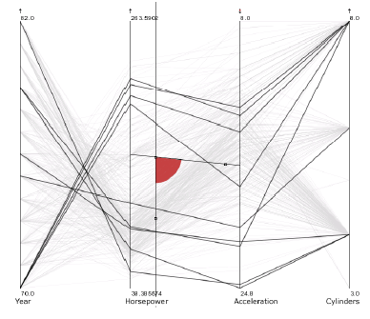
Attribute Ratios
Angular Brushing
Angle between axes indicates level of correlation
Select subsets which exhibit a correlation along two axes by specifying angle of interest
1 –Hauser, H., Ledermann, F., Doleisch, H., “Angular Brushing of Extended Parallel Coordinates,” Proceedings of the IEEE Symposium on Information Visualization (2002), pp. 127–130

Slide 28
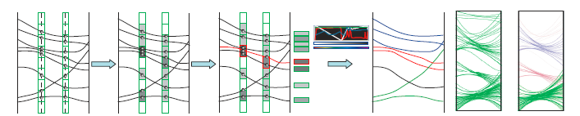
Visual Clustering in Parallel Coordinate Plots
Apply color and opacity based on line density
Compute local density for each line by averaging the density values of all control points
Apply color and opacity based on user specification
Visual Clustering in Parallel Coordinates, Hong Zhou, Xiaoru Yuan, Huamin Qu, Weiwei Cui, Baoquan Chen. Computer Graphics Forum (Proceedings of EuroVis'08), vol. 27, no. 3, 2008.

Slide 29
Pargnostics
Creates lower-dimensional projections that provide maximum insight into the data and optimizes the parameter space for pixel-oriented visualizations
Metrics based on a particular view of parallel coordinate plots
Screen space metrics – depends on the size of the display
Space between the axes is where interesting patterns occur
Dasgupta, A., Kosara, R., “Pargnostics: Screen-Space Metrics for Parallel Coordinate Plots, IEEE Transactions on Visualization and Computer Graphics 16(6): 1017-1026.

Slide 30
Pargnostics
Use a variety of metrics to try and optimize the use of the screen space
One-Dimensional Histogram Distance – records the slope of the lines between the axes
Two-Dimensional Axis pair Histogram – Histogram of all the lines covering both axes
Line Crossings – interpret each line between a pair of axes as a directed interval
Angles of Crossing – Determine angle between line crossings
Dasgupta, A., Kosara, R., “Pargnostics: Screen-Space Metrics for Parallel Coordinate Plots, IEEE Transactions on Visualization and Computer Graphics 16(6): 1017-1026.

Slide 31
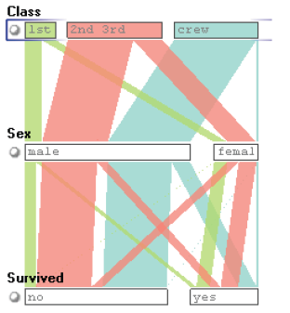
Parallel Sets
Visualization method adopting parallel coordinate layout but uses frequency based representation
Layout similar to parallel coordinate plots
Continuous axes replaced with boxes
Used for categorical data
Robert Kosara, Fabian Bendix, and Helwig Hauser. 2006. Parallel Sets: Interactive Exploration and Visual Analysis of Categorical Data. IEEE Transactions on Visualization and Computer Graphics 12, 4 (July 2006), 558-568

Slide 32
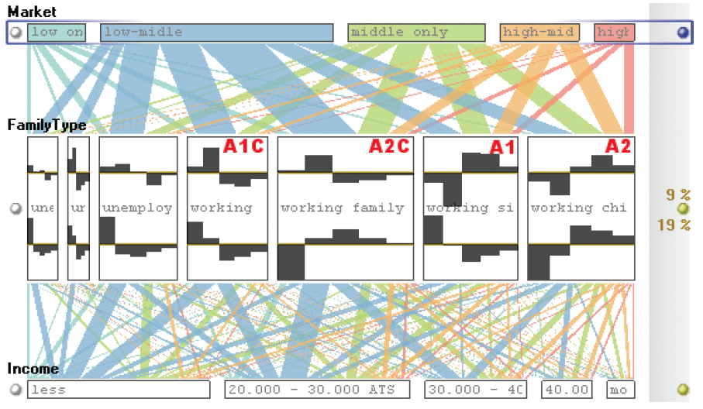
Parallel Sets

Slide 33
Star Plot
Lay out axes in a radial layout, length of a ray emanates from a central point
Rays are then joined together by a polyline drawn around the outside
At Bats
Runs
Batting Average
Infante
RBI
Gonzalez
Votto
S. E. Fienberg,”Graphical Methods in Statistics," The American Statistician, vol. 33 pp. 156-178, 1979.

Slide 34
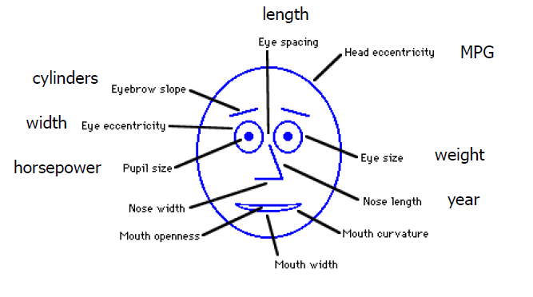
Multivariate Case – Chernoff Faces
1 - Herman Chernoff, The Use of Faces to Represent Points in K-Dimensional Space Graphically, Journal of the American Statistical Association, vol. 68, no. 342, pp. 361–368, 1973
2 - Christopher J. Morris, David S. Ebert, Penny Rheingans, An Experimental Analysis of the Pre-Attentiveness of Features in Chernoff Faces, Proceedings Applied Imagery Pattern Recognition, pp. 12–17, 1999.

Slide 35
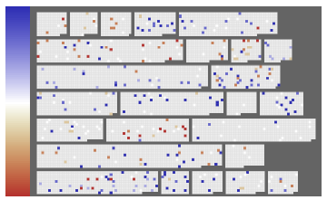
Pixel-Based Displays
1- Keim, DA.: Designing Pixel-oriented Visualization Techniques: Theory and Applications. IEEE Transactions on Visualization and Computer Graphics (TVCG) 6, 1 (2000), 59–78.
2 - Daniela Oelke, Halldor Janetzko, Svenja Simon, Klaus Neuhaus, Daniel A. Keim: Visual Boosting in Pixel-based Visualizations. Computer Graph. Forum 30(3): 871-880 (2011)

Slide 36
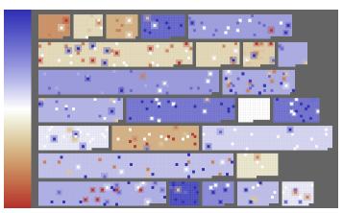
Visual Boosting of Pixel-Based Displays
Could modify the pixel based display to incorporate components that will draw attention to the salient aspects of the data
Halo
Color
Distortion
Hatching
1- Keim, DA.: Designing Pixel-oriented Visualization Techniques: Theory and Applications. IEEE Transactions on Visualization and Computer Graphics (TVCG) 6, 1 (2000), 59–78.
2 - Daniela Oelke, Halldor Janetzko, Svenja Simon, Klaus Neuhaus, Daniel A. Keim: Visual Boosting in Pixel-based Visualizations. Computer Graph. Forum 30(3): 871-880 (2011)

Slide 37
Set Operations
Different type of problem
Large set of items, each can be in one or more set
How do we visually represent the set membership?
Venn Diagrams
Euler Diagrams

Slide 38

Venn Diagram
Often used to illustrate a set
By drawing partly overlapping shapes, different element combinations are assigned to areas
As the number of set elements increases, this becomes impractical
Hard to make all possible element combinations visible
http://blog.visual.ly/euler-and-venn-diagrams/

Slide 39
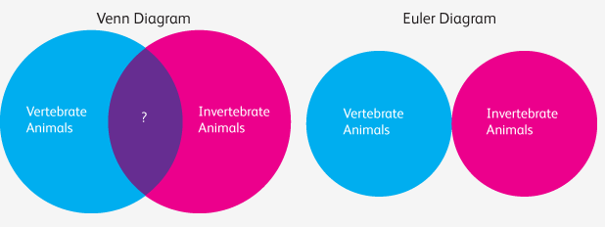
Euler Diagrams
All Venn diagrams are Euler diagrams, but not all Euler diagrams are Venn diagrams
Venn diagrams have every hypothetically possible logical relationship between categories
Euler Diagrams have only those combinations that exist in the real world
http://blog.visual.ly/euler-and-venn-diagrams/

Slide 40
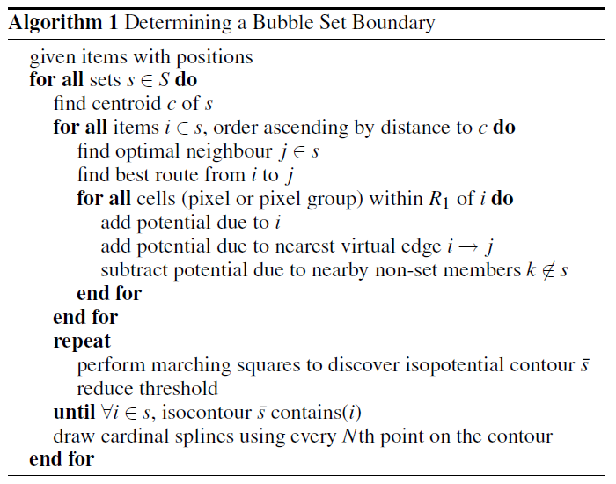
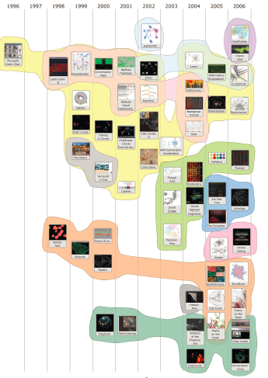
Bubble Sets
Collins, Christopher; Penn, Gerald; Carpendale, Sheelagh. Bubble Sets: Revealing Set Relations over Existing Visualizations. IEEE Transactions on Visualization and Computer Graphics (Proceedings of the IEEE Conference on Information Visualization (InfoVis '09)), 15(6): November-December, 2009.

Slide 41
Coordinated Multiple Views
Instead of trying to make the “best” visualization of all of our data, perhaps we can use multiple views
Data can be expressed in a variety of ways
Given the multivariate nature of data, a single statistical graphic may not be enough
Interactive graphics systems can provide multiple representations of the data
These representations can be linked or coordinated
North C, Shneiderman B (2000) Snap-together visualization Evaluating coordination usage and construction. International Journal of Human-Computer Studies 51:715-739

Slide 42
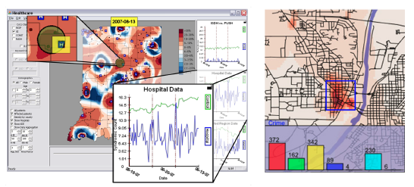
Brushing
Selecting data in one view highlights the same data points in other views
Connecting multiple views through linked brushing provides more information than considering the component visualizations independently
Brushing Scatterplots. R. A. Becker and W. S. Cleveland (1987). Technometrics, 29:127-142

Slide 43
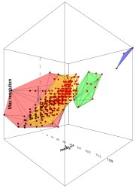
Interaction in Statistical Graphics
Adding interaction can allow us to visualize other combinations of variables
1 - N. Elmqvist, P. Dragicevic, and J.-D. Fekete, “Rolling the Dice: MultidimensionalVisual Exploration Using Scatterplot Matrix Navigation," IEEE Transactions on Visualization and Computer Graphics, vol. 14, no. 6, pp. 1141-1148, 2008..
2 - Jeffrey Heer and George Robertson. 2007. Animated Transitions in Statistical Data Graphics. IEEE Transactions on Visualization and Computer Graphics 13, 6 (November 2007), 1240-1247.

Slide 44
Dust & Magnet
Data cases are represented as small bits of “iron” dust
Different attributes given physical manifestation as magnets
Interact with objects to explore data
Iron bits (data) are drawn toward magnets (attributes) proportional to that data element’s value in that attribute
Higher values are attracted more strongly
All magnets present on display affect position of all dust
Individual power of magnets can be changed
Dust’s color and size can be connected to attributes as well
Moving a magnet makes all the “dust” move
Ji Soo Yi, Rachel Melton, John Stasko, and Julie Jacko, "Dust & Magnet: Multivariate Information Visualization using a Magnet Metaphor," Information Visualization, Vol. 4, No. 4, Winter 2005, pp. 239-256

Slide 45
Summary
We’ve looked at methods that look at a fair number of methods for visualizing high-dimensional data
Unfortunately, as the number of dimensions increase, we get more clutter and methods may fall apart
Data that is similar in most dimensions ought to be drawn together
Need to project the data down into the plane and give it some simplified representation
Only look at certain aspects of the data at one time

Slide 46
Readings and Homework
Required Reading:
L. Wilkinson, A. Anand, and R. Grossman. Graph-theoretic scagnostics.In Proceedings Information Visualization, pages 157–164. IEEE CS Press, 2005.
Ankerst M, Berchtold B, Keim DA (1998) Similarity clustering of dimensions for an enhanced visualization of multidimensional data. IEEE Symposium on Information Visualization pp 52-62
Jeffrey Heer and George Robertson. 2007. Animated Transitions in Statistical Data Graphics. IEEE Transactions on Visualization and Computer Graphics 13, 6 (November 2007), 1240-1247Homework
Homework #2 is due Wednesday

Slide 47
Questions?

